Slide 1
Team 1: Progress
Presentation
By: Jonathan Alavez Reyes, Faahil Ali, Liya Aji, Margaret Decker, Sabrina Abdukadirova

Slide 2
Table Of Contents
Tab Number | Section
1 | Yards Canning Production Line
2 | Yards Variety-Pack Production Process
3 | Yards Variety-Pack Can Types & Packaging
4 | High-Speed Cameras & Smart Cameras
5 | OpenCV for Image Defect Detection
6 | Ideas for Prototype & Solutions

Slide 3
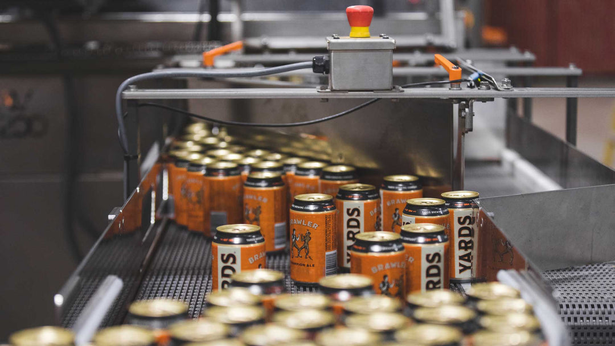
Tab 1: Canning Production Line
Step 1: Depalletizer, Mass Conveyor, & Single-File Can Alignment
Step 2: Invertor 1 for Ionized Air & Vacuum
Step 3: Date/Lot or Batch Code and Invertor 2 to Reorient Cans
Step 4: Can Down Sensor for Detection
Step 5: CO2, Filled, & Sealed via Double Seaming Process
Step 6: X-Ray Machine, High/Low Fill Level Check
Step 7: Packaging Area to Different Packaging Formats
Step 8: Manual Finished Case Packaging
Notes:
Here are the steps for the canning process at Yards Brewery.
First, empty cans enter through the depalletizer and mass conveyor, where they are organized into a single-file line. The cans are then inverted by Invertor #1, allowing ionized air and vacuum to remove dust and debris from the inside. While still inverted, a date and lot code are printed on the bottom of each can before Invertor #2 returns them to the upright position.
Next, a can-down sensor detects and rejects any cans that have fallen over or are not properly oriented. The remaining cans are flushed with CO₂ to reduce oxygen exposure, filled with beer, and sealed using a two-stage double-seaming process.
After sealing, the cans pass through an X-ray inspection system that checks for high or low fill levels and rejects any cans outside the acceptable range.
Finally, the approved cans move to the packaging area, where they are assembled into different package formats, including variety packs, before workers complete the final packaging and palletizing process."

Slide 4
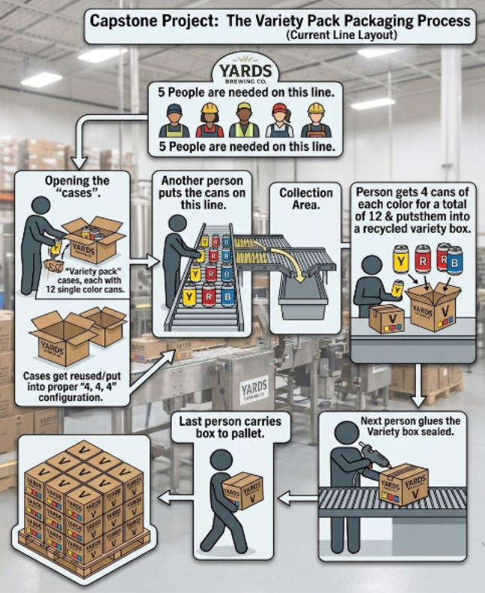
Tab 2: Variety Pack Production Process
Typically 5 and/or 2 Person Manual Process
2 Workers Open and Remove Cans from Cases
Empty Boxes Reused as Variety Pack Boxes
3 Flavor Types Placed on Conveyor Belt
2 Workers Select Cans to Put into Boxes
Each Pack = 12 Cans (4 Cans x 3 Flavors)
Flavors Change; Pale Ale, IPA Variation
  Examples: Philthy, Gold, Trash talk
After Filling, 1 Worker Seals via Glue Machine
Stacked for Shipment
Manual: Quality, Counting, Inventory Issues
Liya
Notes:
This diagram shows the current variety-pack packaging process at Yards Brewery.
Unlike the main canning line, variety packs are assembled in a separate area after individual flavors have already been packaged and stored. Because the canning line can only run one flavor at a time, completed cases from different flavors are brought to this station later and combined into mixed packs. The process typically requires five workers, but it can also be done by a minimum of 2 workers. First, 2 workers open the completed cases and remove the cans. The empty boxes are then reused as variety-pack boxes and placed on the top of the conveyor belt.
Next, cans from typically 3 different flavors are placed onto separate conveyor lanes. 2 Workers manually select cans from each lane and place them into the variety-pack boxes. Each variety pack contains 12 cans, which is typically four cans of three different flavors. The flavors are always changing, but some could be Pale Ale or variations of IPAs (Trash talk, Philthy, Gold, etc.).
After the box is filled, another worker seals it using the glue machine, and the finished variety packs are stacked for shipment.
One of the biggest challenges with this process is that it is very manual. Workers must count cans and select the correct flavors by hand, which can lead to counting mistakes due to them engaging in conversation or not paying attention, incorrect flavor combinations, and inventory issues. Because of these quality problem, this part of the processes can be improved through automation.

Slide 5
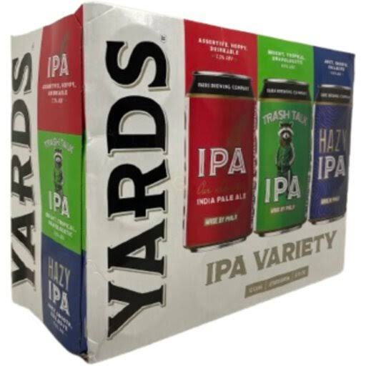
Tab 3: Variety Can Types and Packaging
Yards canning line only produces single beer SKUs per day, and stores cans destined for variety packaging in variety boxes
Yards uses a "variety stitch" on variety boxes, so that they can be then reused when put into proper configuration
Current main variety packaging type includes 3 beer types, and 4 cans per type for a total of 12 cans in a variety box
Historically, there have been 4, and 2 product configurations, but the can size remains the same across all configurations (12oz)
Yards loads same can types into the same conveyor belt lanes that push the cans to the next station
Cans are side-loaded horizontally into the reused variety box, so there's room for can loading automation
Aluminum cans are fragile, so any pushing/gating mechanism should minimize or prevent any damaging impacts.
John

Slide 6

Tab 4: High-Speed Camera
Best suited camera is ELP Camera due to cost and our needs
High-speed and global shutter
80-200 frames per second depending on quality we need and speed of the belt
  (1080p for lower frame rate)
2MP
Variable aperture – we'll have to experiment with the zoom and distance from the cans
Will need a good light fixture to maintain quality
  Industrial level light with diffusing and polarizing will light more space and reduce glare
  Continuous light vs strobing light
Margaret
Notes:
Global shutter – the image is taken all at once instead of row by row as a rolling shutter would; this reduces motion blur but calls for higher lighting
Variable aperature – aperature controls how much light is let in to capture an image; VarAp lets in less light when zoomed in
Continuous light – easier to set up, but can cause motion blur if the shutter speed isn't fast enough
Strobing light – harder to set up, but reduces motion blur as flash occurs right before picture is taken (industrial level lights have safe strobing for workplace safety)

Slide 7
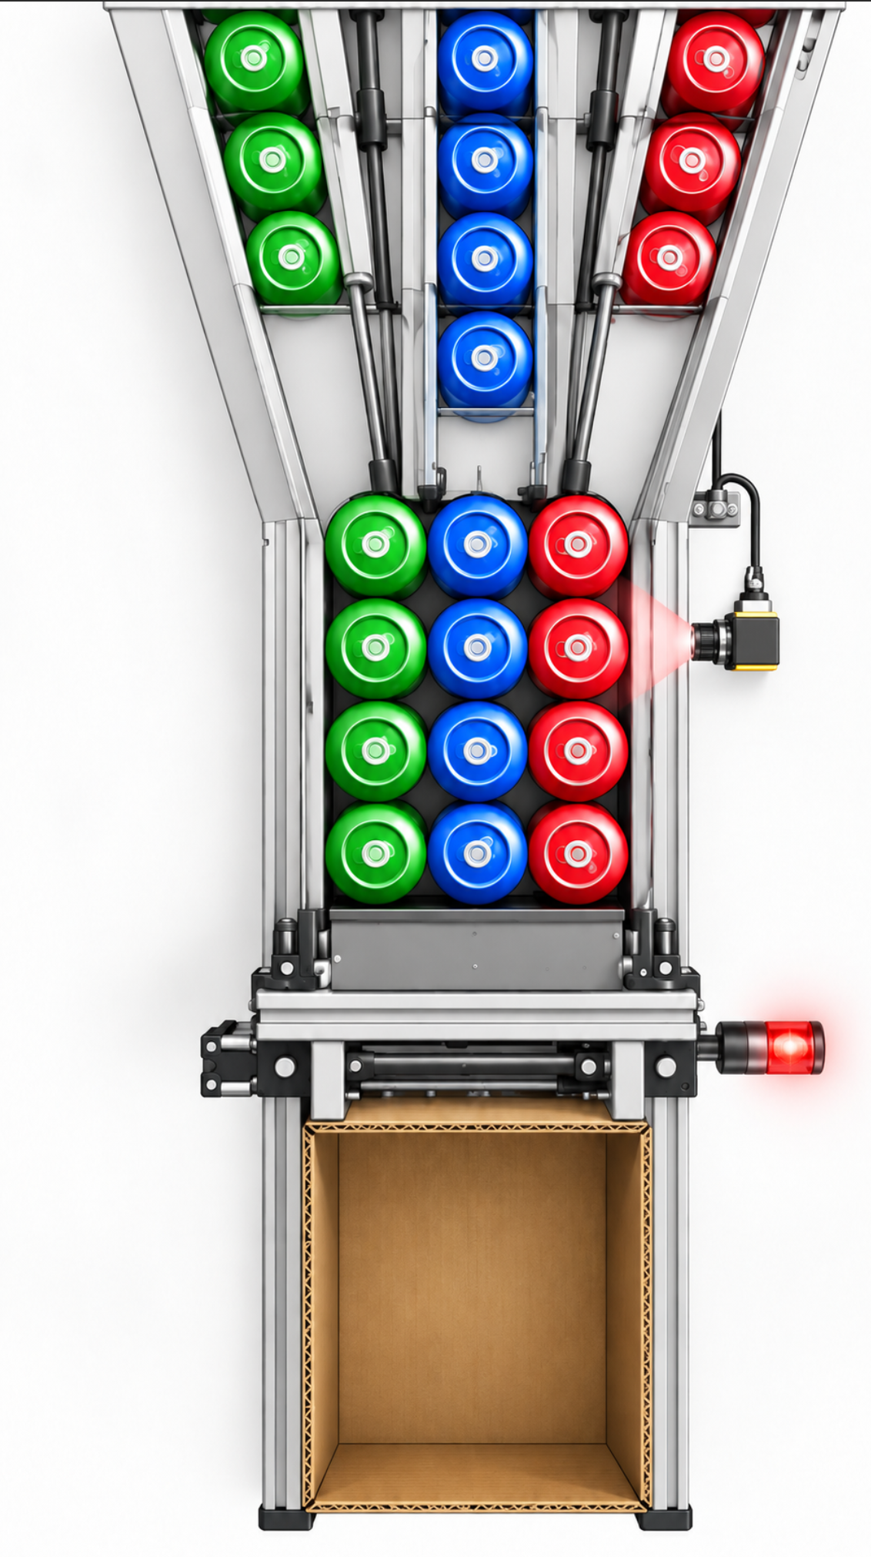
Tab 5: OpenCV for Image Detection
Camera checks the cans before they are pushed into the box
OpenCV identifies & counts each can variety
Detected cans are compared with the selected recipe
  Ex: 4 Red + 4 Blue + 4 Green = 12 cans
PASS: Correct combination → pusher continues
FAIL: Wrong combination → pusher stops & alerts operators
Acts as a quality-control backup to the gates and sensors.
AI can be considered later if basic color detection is not reliable enough.
Flow:
Camera → OpenCV → Count Varieties → Compare Recipe → PASS / FAIL
Faahil

Slide 8
Tab 6: Prototype Ideas
Proposed solutions
3 conveyor lanes for different beer flavors.
Double gate system to count and release cans
Pusher/guides to load cans into the box
A Camera that verifies that the variety is properly set with no mistakes.
Failsafe system that stops the conveyor and alerts the operator if an error occurs.
Thin stainless-steel plates could be used to enter the carton openings.
Current design status
Prototype is still in the design stage.
Final measurements need to be confirmed
It is confirmed that the mechanical hardware will be provided by yards.
The biggest remaining challenge is making sure cans can be loaded without denting or jamming. The next step includes testing the design in yards.
Sabrina

Slide 9
Conclusion
The prototype is moving from the design stage toward testing and implementation. Next, the team will confirm final measurements, determine available hardware, and test the proposed system at Yards. Based on those results, the design can be adjusted before building the final prototype.
Thank you!

